Slide 1
Deep Sequential Architectures for Financial Time Series Classification
CMPE 679 Deep Learning Project Progress Report
Obumneme Umeonwuka & Gloria Mbaka
Rochester Institute of Technology
Notes:
Good afternoon. our project studied whether deep sequential neural architectures can improve short-horizon Bitcoin direction prediction relative to classical machine learning baselines.

Slide 2
Outline
Problem and Motivation
Research Question and Hypothesis
Background/Literature Review
Dataset and Problem Setup
Model Architectures
Training and Evaluation
Overall Classification Results
Calibration and Confidence
Backtesting Results
Future Work

Slide 3
Problem and Motivation
Problem & Background
Problem
Short-horizon financial prediction is difficult
Minute-level Bitcoin data are noisy, nonlinear, and non-stationary
Signal-to-noise ratio is very low at high frequency
Motivation
Classical models do not explicitly model temporal structure
Deep sequence models may capture temporal dependencies better
Important to test whether more complex models actually improve prediction and trading usefulness
Notes:
Financial markets generate sequential data, but short-horizon prediction is extremely difficult because the data are noisy and rapidly changing. This project was motivated by the question of whether deep sequence models really provide an advantage over strong classical baselines in this kind of setting.

Slide 4
Research Question and Hypothesis
Problem & Background
Research Question
How do different sequential deep learning architectures compare in learning temporal representations for short-horizon Bitcoin direction prediction?
Initial Hypothesis
Deep sequential models would outperform classical baselines
Hybrid and multitask models might further improve robustness
Better classification was expected to improve trading outcomes
Notes:
The main question was how different deep sequence models compare on short-horizon Bitcoin direction prediction. Our initial expectation was that deep recurrent, hybrid, and multitask models would outperform classical baselines because they explicitly model temporal dependencies.

Slide 5
Literature Review I
Problem & Background
Short-Horizon Market Predictability: Cryptocurrency markets exhibit high volatility and weak short-term autocorrelation. Jaquart et al. [1] showed that predictive performance is highly sensitive to horizon selection and chronological validation. This motivated the use of strict time-based splits and careful target construction in this study.
Convolutional Architectures: Bai et al. [2] showed that convolutional sequence models can outperform recurrent networks in some sequence tasks. CNNs capture local temporal patterns using shared filters and can model longer dependencies through dilation.
Recurrent Architectures: LSTM [3] introduced gated memory cells to mitigate vanishing gradients, while GRU [4] simplified gating while maintaining competitive performance. Siami-Namini et al. [5] also reported strong forecasting performance for LSTM and GRU in time series settings.
[1] P. Jaquart, D. Dann, and C. Weinhardt, “Short-term bitcoin market prediction via machine learning,” 2021.
[2] S. Bai et al., “An empirical evaluation of convolutional and recurrent networks for sequence modeling,” 2018.
[3] S. Hochreiter and J. Schmidhuber, “Long Short-Term Memory,” Neural Computation, 1997.
[4] K. Cho et al., “Learning phrase representations using RNN encoder–decoder,” EMNLP, 2014.
[5] S. Siami-Namini et al., “The performance of LSTM and GRU networks in time series forecasting,” IEEE Big Data, 2018.
Notes:
Prior Bitcoin studies showed that short-horizon prediction is highly sensitive to horizon selection and chronological evaluation, which motivated my time-aware data split and target design. The broader sequence-modeling literature also supported testing both convolutional and recurrent architectures, since CNNs capture local temporal patterns while LSTM and GRU remain strong baselines for sequential forecasting..

Slide 6
Literature Review II
Problem & Background
Hybrid CNN–RNN Models: DeepLOB [6] showed that convolutional layers can extract hierarchical representations which are then modeled sequentially using recurrent networks. This motivated the inclusion of CNN–GRU style hybrid architectures in this project.
Attention and Transformers: Transformers replace recurrence with self-attention [7]. Temporal Fusion Transformer extends attention mechanisms for interpretable multi-horizon forecasting [8]. These works motivated the inclusion of transformer-based models in this study.
Financial Machine Learning Perspective: López de Prado [9] emphasized the importance of leakage control, chronological validation, and realistic evaluation in financial machine learning. These principles motivated the use of purge gaps, chronological splits, calibration analysis, and backtesting in this project.
[6] Z. Zhang et al., “DeepLOB: Deep convolutional neural networks for limit order books,” IEEE Transactions on Signal Processing, 2019. [7] A. Vaswani et al., “Attention is all you need,” NeurIPS, 2017. [8] B. Lim et al., “Temporal Fusion Transformers for interpretable multi-horizon forecasting,” International Journal of Forecasting, 2021. [9] M. López de Prado, Advances in Financial Machine Learning. Wiley, 2018..
Notes:
Hybrid and attention-based literature further motivated the project. DeepLOB showed the value of combining convolutional and recurrent layers for financial sequence modeling, while transformer literature motivated the inclusion of attention-based models. Financial machine learning literature also emphasized realistic evaluation, which influenced my use of purge gaps, calibration analysis, and backtesting.

Slide 7
Dataset and Problem Setup
Methodolgy
Dataset
Bitcoin 1-minute market data
OHLCV variables used as the starting point
Target
Short-horizon binary direction classification
Future log return over a 10-minute horizon
Threshold filtering used to remove near-zero noisy movements
Data preparation
Strict chronological train / validation / test split
Purge gap used to reduce leakage near split boundaries
Engineered feature space built from OHLCV-derived indicators
Fixed input window length: 240 timesteps
Sequence stride: 10
Notes:
We used minute-level Bitcoin data and formulated the task as binary direction classification based on future log return over a 10-minute horizon. To reduce noise, we applied threshold filtering so that only meaningful price movements were kept. We also used strict chronological splitting and a purge gap to avoid look-ahead leakage. Each input sample used a fixed historical window of 240 timesteps, and sequences were generated with stride 10.

Slide 8
Model Architectures
Methodolgy
Input representations
Baselines: tabular summaries from window statistics
Deep models: fixed-length sequences of engineered feature vectors
Single-task models
Logistic Regression
Random Forest
XGBoost
MLP(summary)
MLP(sequence)
CNN1D (TCN Backbone)
GRU
LSTM
CNN-GRU
CNN-Transformer-Attn
TransformerEncoder
Multitask models
Added auxiliary tasks:
regime classification
future return regression
Notes:
Our method is to compare classical baselines with deep sequence models under a unified framework. Further multitask learning was done on deep models, by adding auxiliary heads for regime classification and future return regression to see whether additional supervision would improve the main direction task.

Slide 9
Training and Evaluation
Methodolgy
Training
AdamW optimizer
regularization through dropout and weight decay
gradient clipping
OneCycle learning-rate scheduling
fixed evaluation threshold of 0.5
Early stopping
Evaluation metrics
Accuracy
Balanced Accuracy
Macro F1
Weighted F1
Brier score
Expected calibration error
Practical evaluation
Simplified event-style backtesting framework
Notes:
All models were evaluated with both classification metrics and calibration metrics. we also included backtesting because a model that looks slightly better in classification may not actually perform best in trading.

Slide 10
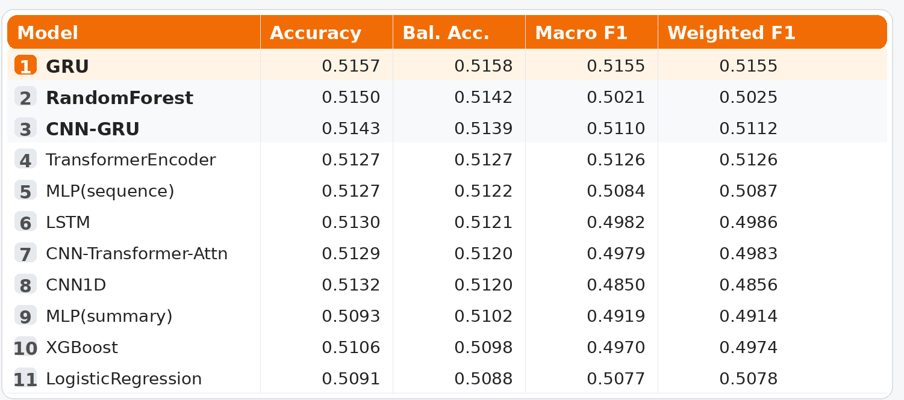
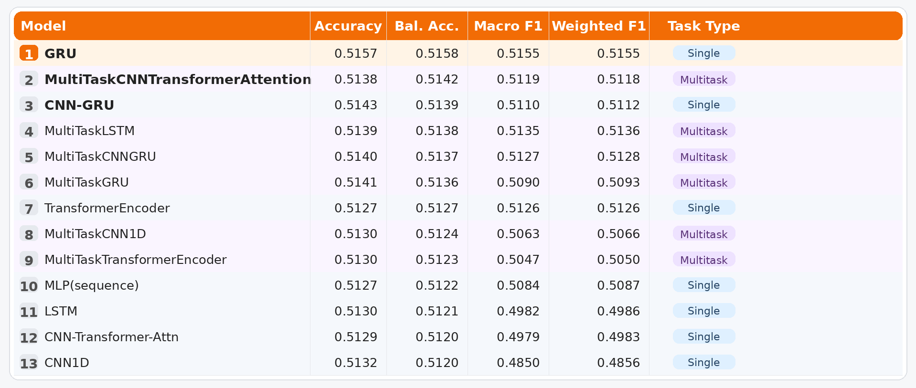
Overall Classification Results
Results
Table 1: Combined single-task leaderboard on the test set
Table 2: Comparison between single-task and multitask models on the test set
Main finding
Deep models did not produce a dramatic improvement over strong classical baselines
Multitask learning was competitive, but not better than the best single-task model
Notes:
The best classifier was GRU, but the gain over Random Forest was very small. This means the deep models were only modestly better than the strongest baseline. Also, multitask learning did not beat the best single-task model.

Slide 11
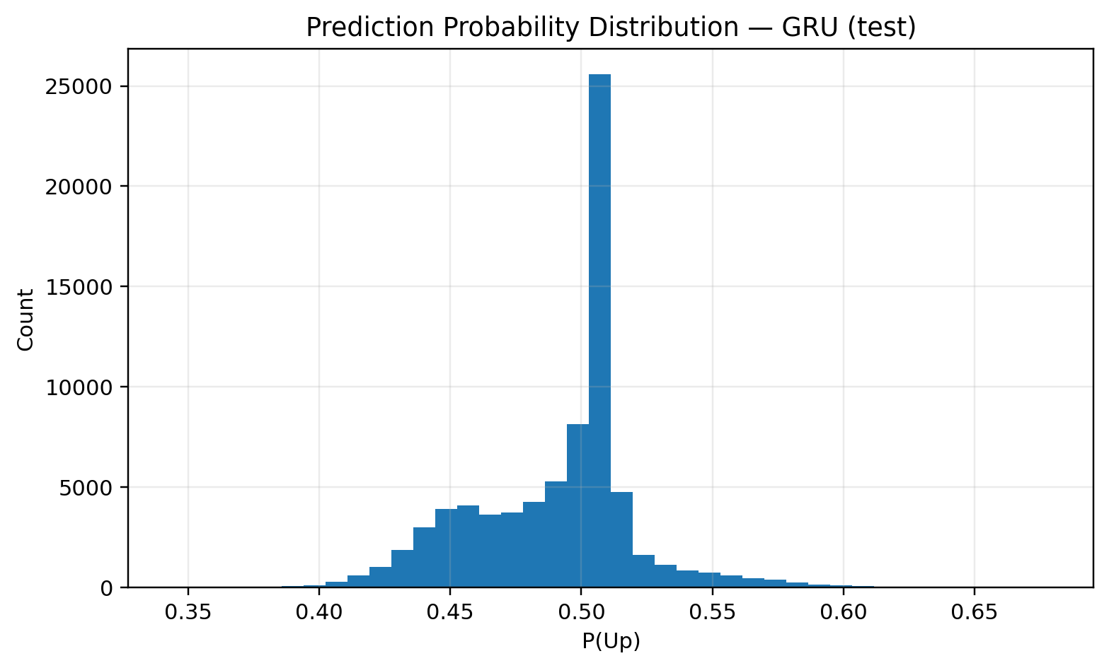
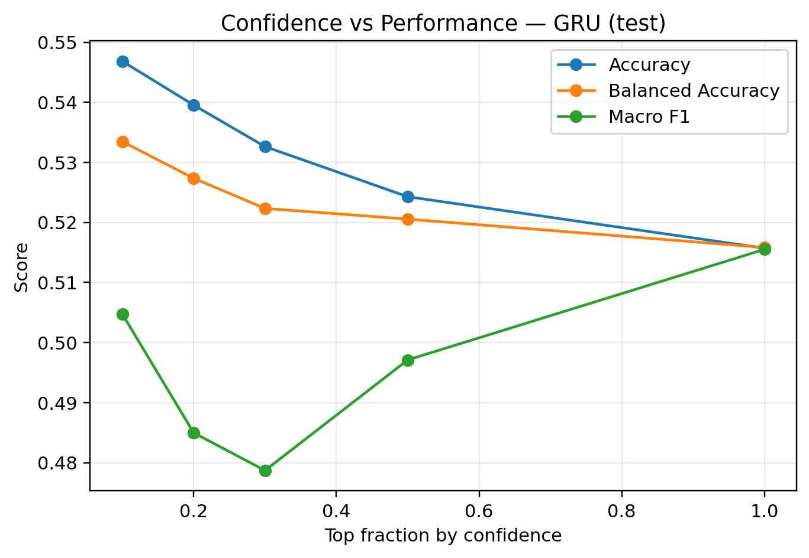
Calibration and Confidence
Results
Observed behavior
Predicted probabilities were mostly concentrated near 0.5
Confidence filtering improved performance only slightly
Models showed limited ability to identify strongly separable high-confidence cases
Interpretation
Models were not severely miscalibrated
Main problem was weak predictive signal, not unstable probabilities
Figure 1: GRU probability histogram
Figure 2: GRU confidence curve
Notes:
The calibration analysis showed that predicted probabilities were concentrated near the decision threshold. This means the models were uncertain most of the time. Confidence filtering helped a little, but not enough to reveal a strong subset of highly reliable predictions.

Slide 12
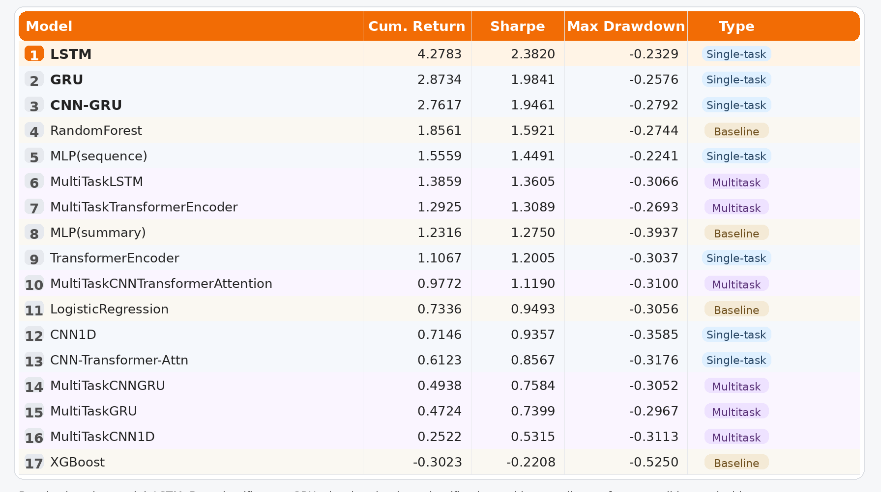
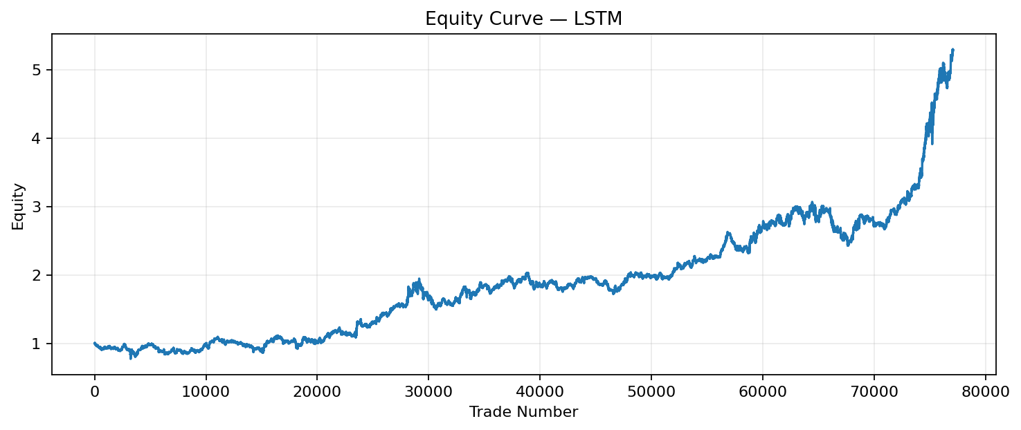
Backtesting Results
Results
Table 3: Combined backtesting results across baseline, single-task,and multitask models.
Figure 3: LSTM equity curve
Key insight
Best classification model was not the best trading model
Backtesting equity is normalized
Final equity above 5 means more than 5x starting capital in the simplified framework.
Growth was strong, but not smooth
Notes:
This was one of the most important findings of the project. The best classifier was GRU, but the best trading result came from LSTM. So slight differences in classification metrics did not map directly to the strongest trading performance. The equity is normalized, so a value above 5 means 5x starting capital under the simplified backtest. The path was profitable, but there were still noticeable pullbacks.

Slide 13
Future Work
More targeted tuning of recurrent models
Improve target design and confidence-aware decision rules
Use more realistic backtesting with costs and slippage
Test richer inputs such as order book imbalance and trade flow
Explore whether market microstructure data gives deep models a clearer advantage
Notes:
The next stage of this project should focus less on adding complexity and more on improving the information content of the inputs, refining the target design, and strengthening the realism of the evaluation framework.

Slide 14
References
[1] P. Jaquart, D. Dann, and C. Weinhardt, “Short-term bitcoin market prediction via machine learning,” 2021. [2] S. Bai et al., “An empirical evaluation of convolutional and recurrent networks for sequence modeling,” 2018. [3] S. Hochreiter and J. Schmidhuber, “Long Short-Term Memory,” Neural Computation, 1997. [4] K. Cho et al., “Learning phrase representations using RNN encoder–decoder,” EMNLP, 2014. [5] S. Siami-Namini et al., “The performance of LSTM and GRU networks in time series forecasting,” IEEE Big Data, 2018. [6] Z. Zhang et al., “DeepLOB: Deep convolutional neural networks for limit order books,” IEEE Transactions on Signal Processing, 2019. [7] A. Vaswani et al., “Attention is all you need,” NeurIPS, 2017. [8] B. Lim et al., “Temporal Fusion Transformers for interpretable multi-horizon forecasting,” International Journal of Forecasting, 2021. [9] M. López de Prado, Advances in Financial Machine Learning. Wiley, 2018.

Slide 15
Thank you
Questions?

